Slide 1
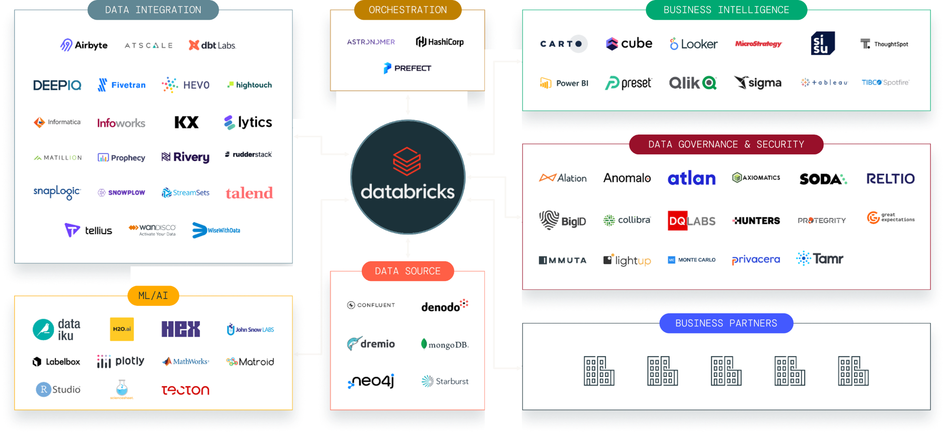
Built on an open foundation
Easily integrate with the entire data and AI ecosystem
Notes:
All of this has been built on open source and open standards
Integrating with tools you have today or new technologies you may adopt tomorrow is made simple
Additionally, Delta Lake’s Delta Sharing protocol allows you to easily share data and assets externally and internally without any vendor dependance
And even facilitate data cleanrooms for highly secure joint analytics with your partners

Slide 2

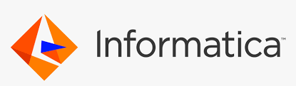


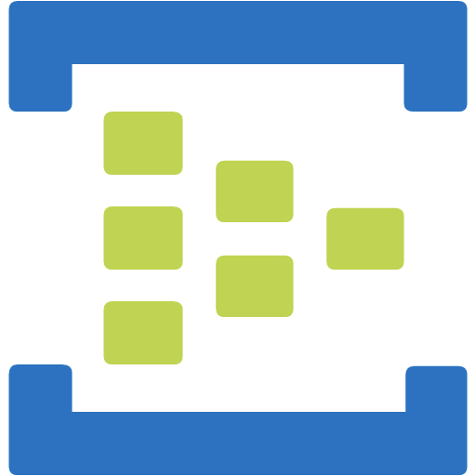

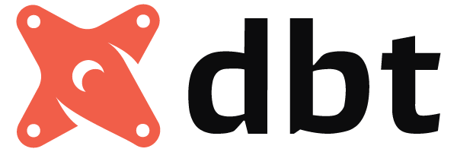
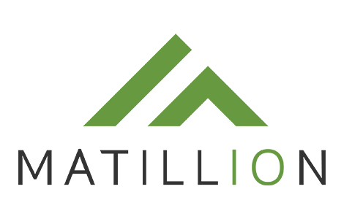





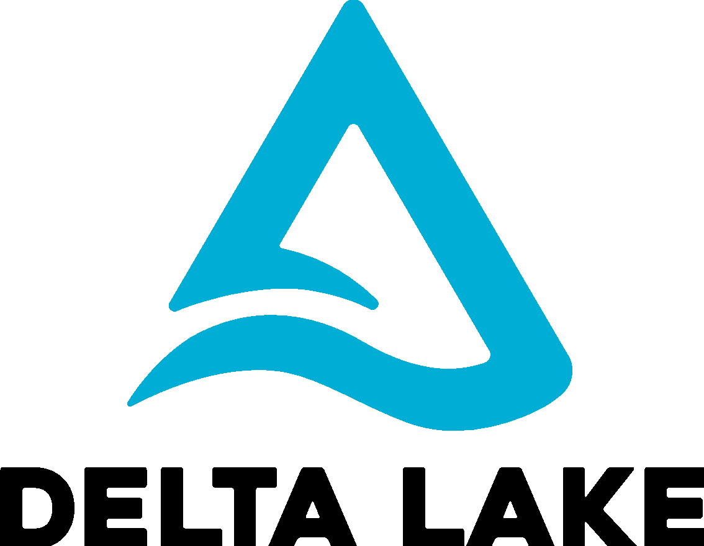


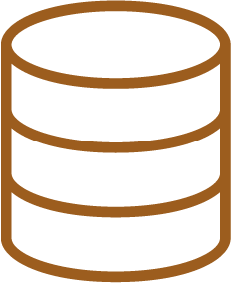
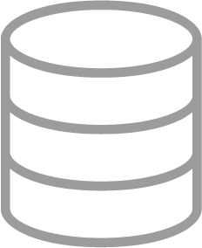
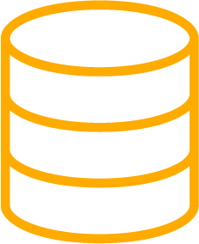

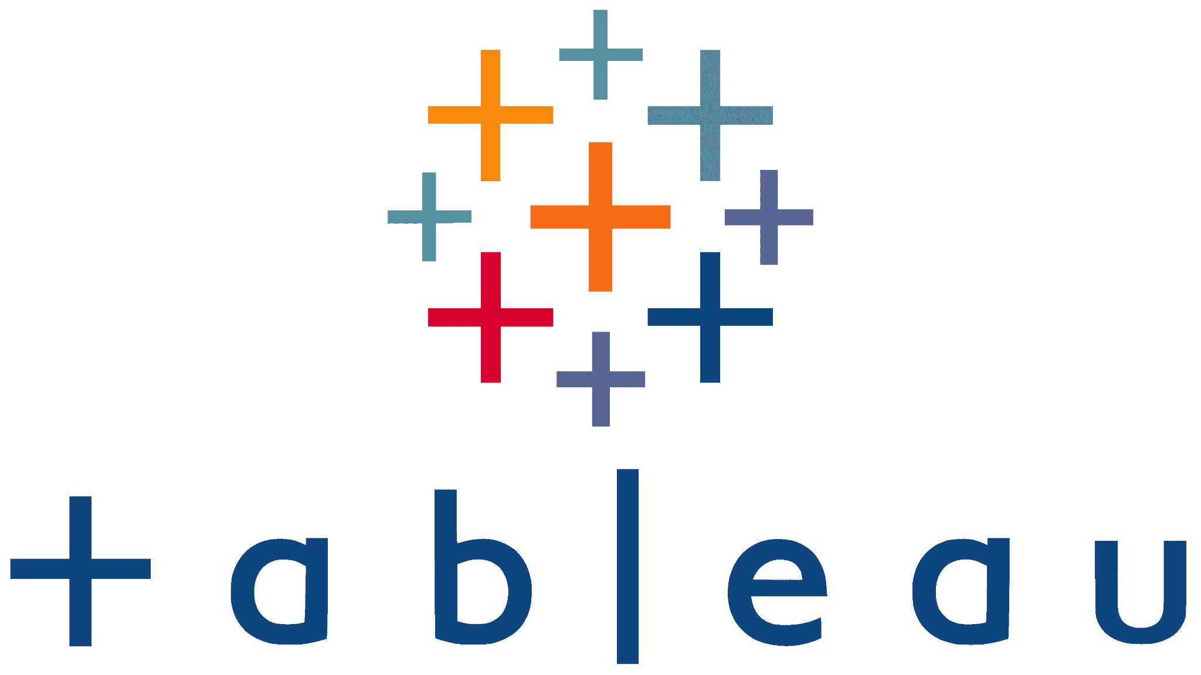








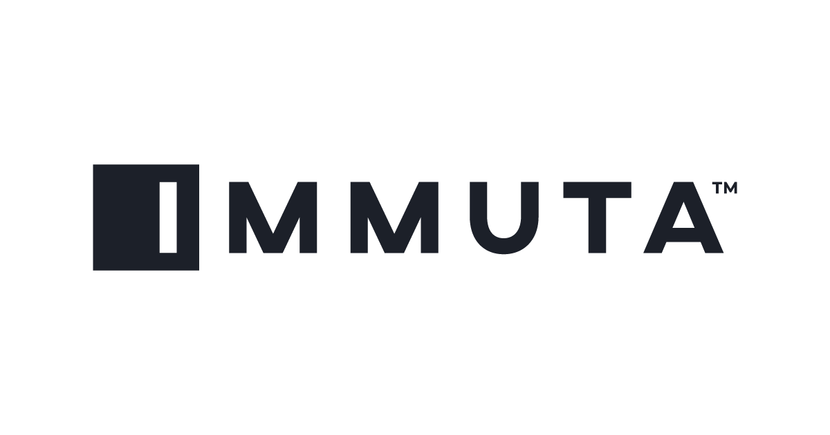

Modern Data Warehousing on Databricks
Stream Ingestion
ETL Partners
Databricks Notebooks, Delta Live Tables
Data Science and Machine Learning
Curated Data
Real time CDC
Databricks Machine Learning
BRONZE
SILVER
GOLD
DBSQL Warehouse
Enterprise Reporting and BI
Raw Ingestion and History
Filtered, Cleaned, Augmented
Business Aggregates & Data Models
Databricks SQL
Data Governance powered by Databricks Unity Catalog
EDC
Notes:
First step is to select the right Partner Ecosystem to Ingest the data, decide on whether your team is comfortable with Databricks Notebook-based ETL or do they prefer GUI-based ETL tools such as Matilltion, Prophecy, DBT, Informatica etc. Also select a proper Semantic layer and Reporting tools and decide on how to enforce your Enterprise Data Governance policies. Databricks Unity Catalog provides full fine-grained security and governance on Databricks and it also integrates well with Immuta or Privacera for security and Alation, Collibra and Informatica Data Catalog for Lineage and Search.

Slide 3
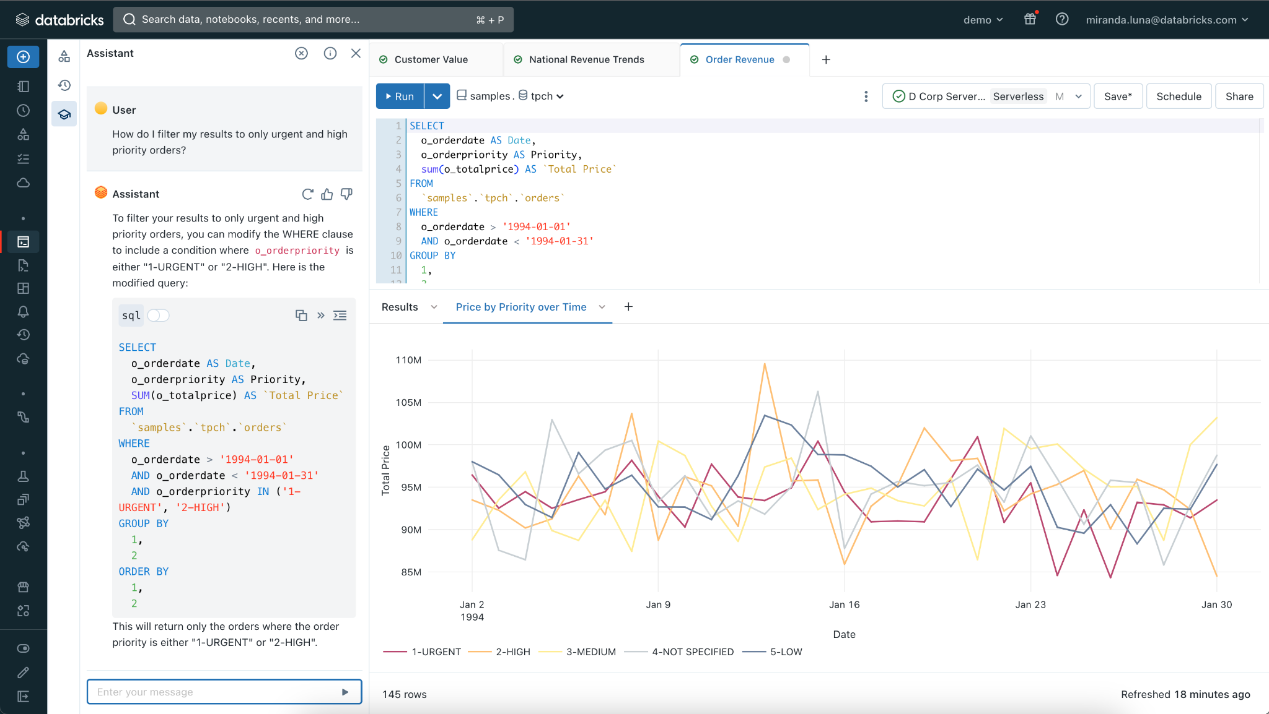
Data Consumption: Integrated Analytical Tooling
Collaboratively query, explore, and transform data in-place
Discover data, explore database schema, and query data using ANSI SQL
Save, share, and reuse queries across teams to get to results faster
Up next: Integrated SQL authoring assistant
Build interactive visualizations and dashboards
Stay up to date with alerts and automatic refresh schedules
Notes:
In addition to supporting your existing SQL and BI tools, we are also focused on providing a first-class SQL development experience within Databricks. We continuously talk with analysts that use various SQL editors like SQL workbench everyday, and work with them to provide the dream set of capabilities for SQL development.
Databricks SQL offers a full-featured SQL editor that allows analysts to write queries in a familiar syntax (ANSI SQL supported in addition to Spark SQL) and easily explore schemas. Regularly used SQL code can be saved as snippets for quick reuse, and query results can be cached to keep run times short. Additionally, query updates can be scheduled to automatically refresh, as well as to issue alerts when meaningful changes occur in the data. Databricks SQL also allows analysts to make sense of data through visualizations and drag-and-drop dashboards. Once built, dashboards can be easily shared with stakeholders, both within and outside the organization, via a web browser.

Slide 4






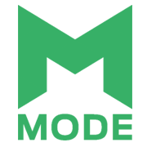
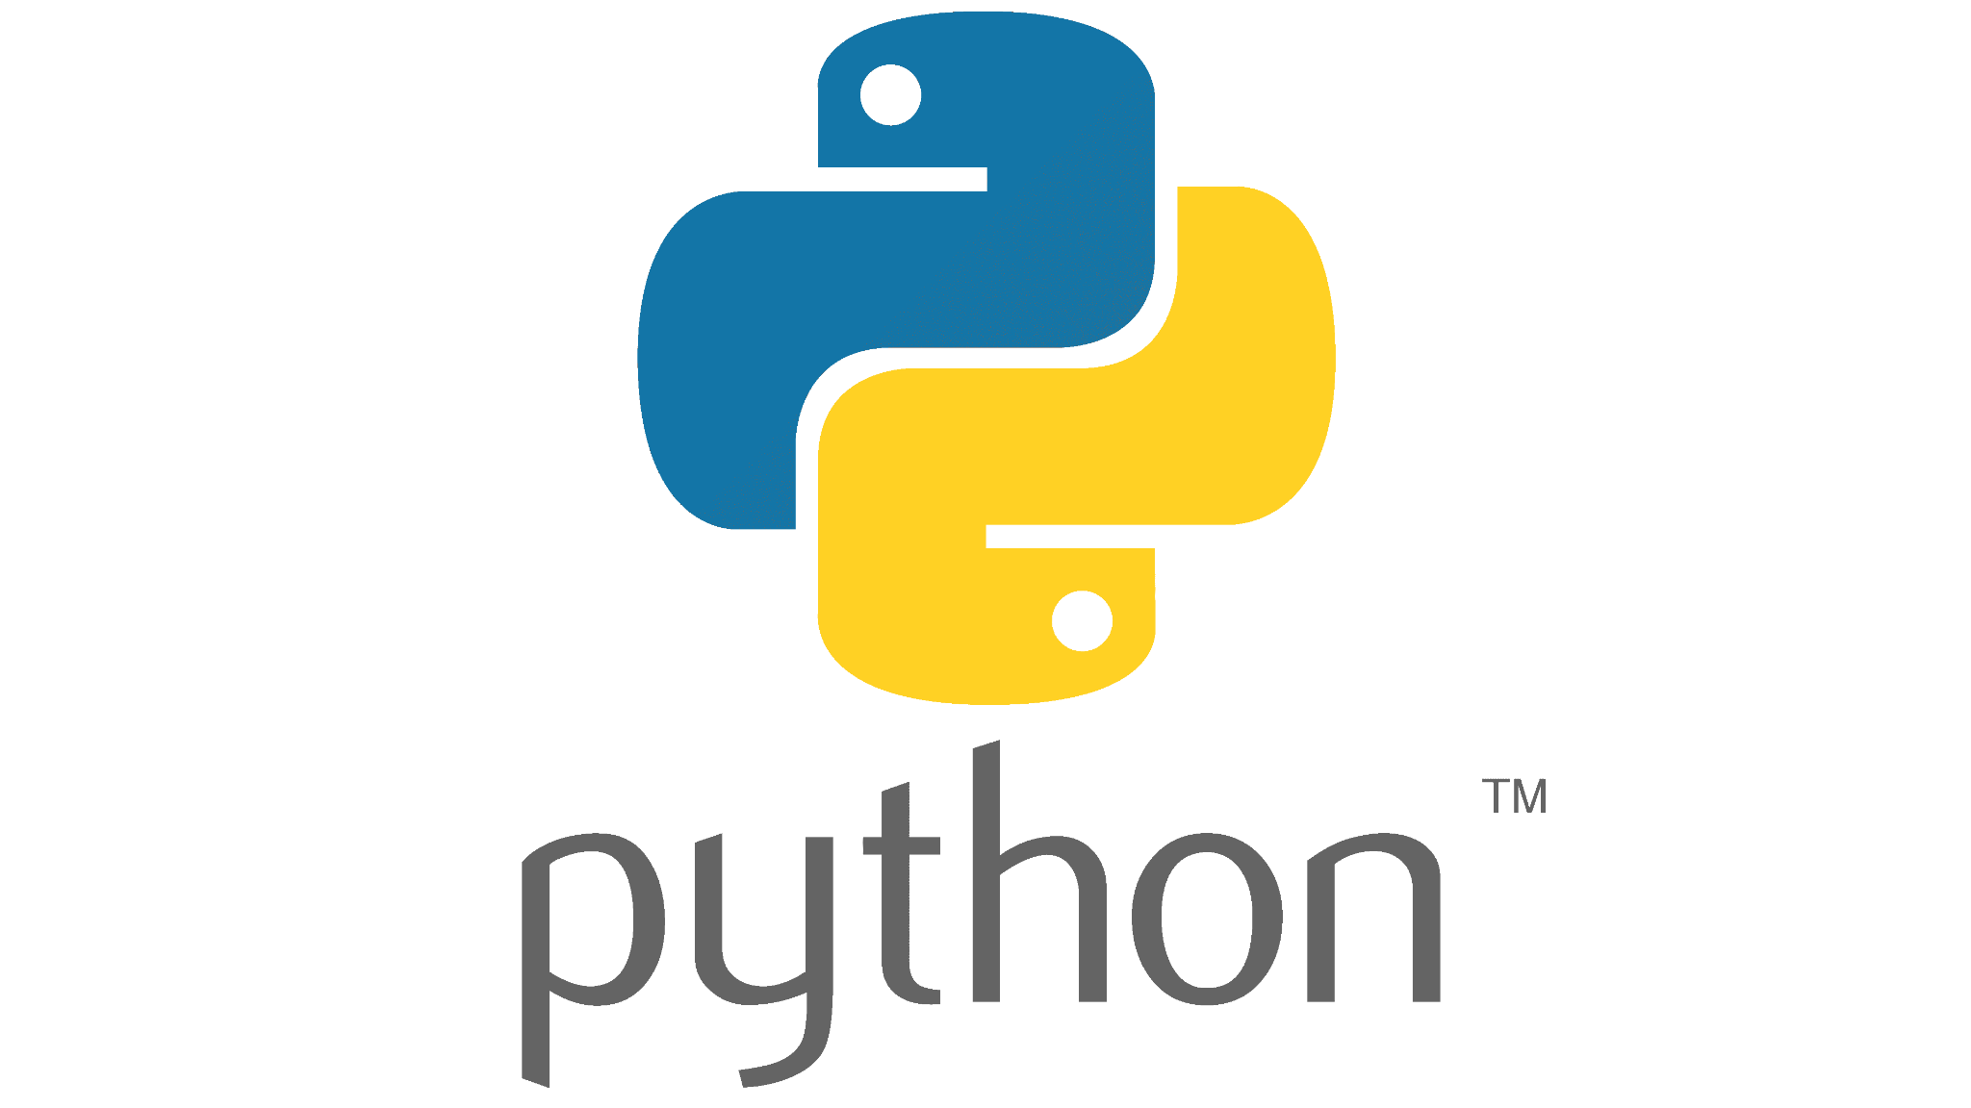
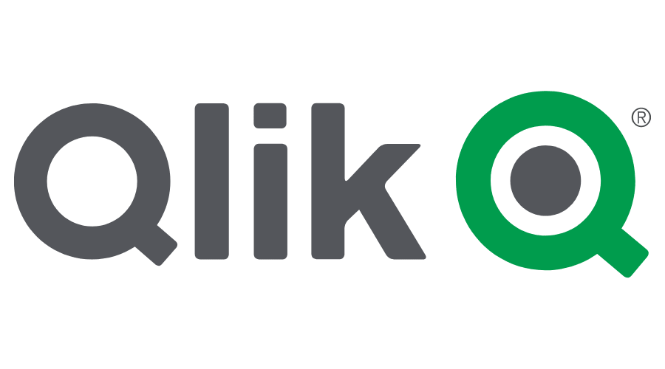



Data Consumption: Ecosystem Support
Query from any tool
Connect existing dashboards or brand new ones to the latest and freshest data, leverage your favorite tools to find new insights, and build custom data apps powered by the lakehouse with tools and languages you already know.
{REST:API}
And more…
Notes:
Connect existing BI tools and dashboards or brand new ones to the freshest data using OAuth or PAT tokens
Leverage your favorite SQL workbenches or IDE to find new insights
Build custom data apps powered by the lakehouse with tools and languages you already know

Slide 5
DBSQL System Tables
Bronze tables providing visibility into platform activity
What statements were run by whom & when?
> warehouse_events
> warehouses
How & when did warehouses scale?
> statement_history
What was I billed for?
> billing
Sign up @ tinyurl.com/sys-tables

Slide 6
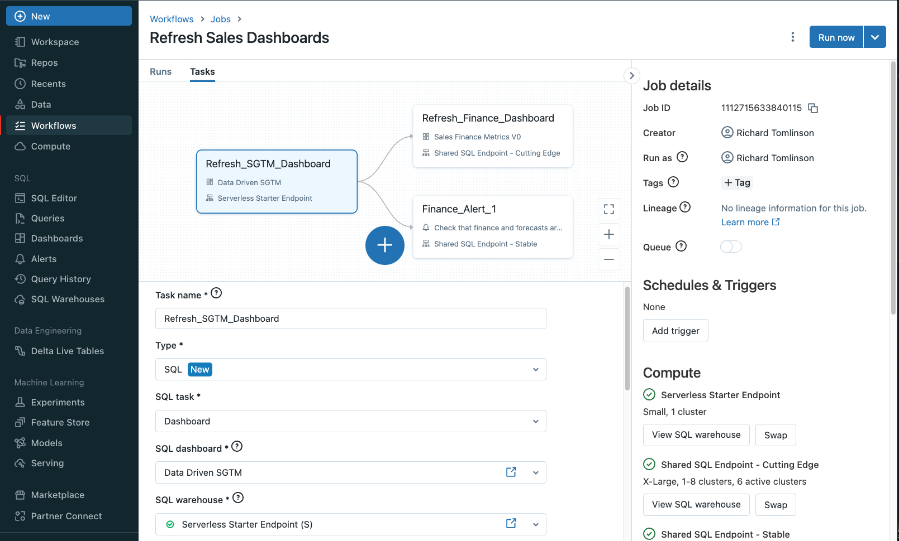
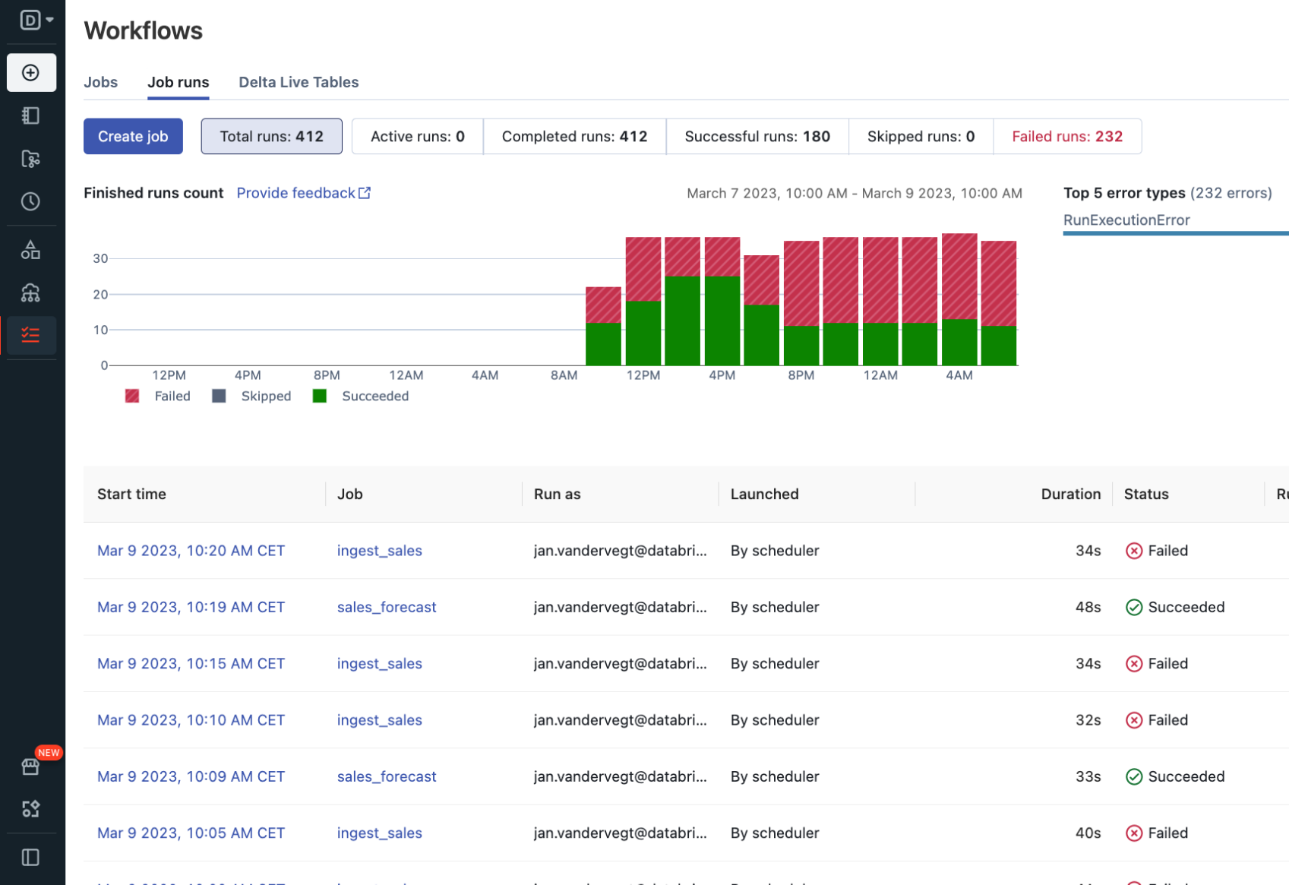
Data Transformation: Workflows + Databricks SQL
Orchestrate your SQL queries, dashboards, alerts, and more
Schedule and automate your Databricks SQL production workloads
Easily orchestrate sophisticated workflows with multiple dependencies
Enhanced monitoring and observability with proven reliability in production
Up next: Native integration with dashboards, SQL queries and alerts

Slide 7






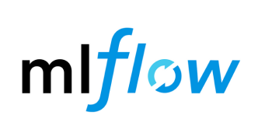
Databricks Workflows
Data Intelligence Platform
Workflows
Orders
Join
Aggregate
Analyze
Clicks
Sessions
Featurize
Train
Unified orchestration for data, analytics, and AI on the Data Intelligence Platform
Data Ingestion
& Transformation
Data Warehousing
Machine Learning
Simple authoring
Actionable insights
Processing Engine (Photon)
Governance (Unity Catalog)
Proven reliability
Storage (Delta Lake)
Notes:
The Databricks Lakehouse platform is a unified solution for data, analytics and AI and Databricks Workflows is the unified, native orchestration solution built for the lakehouse and offers these key advantages:
Simple authoring
Actionable insights
Proven reliability
In the next several slides we’ll explore each one of these…

Slide 8
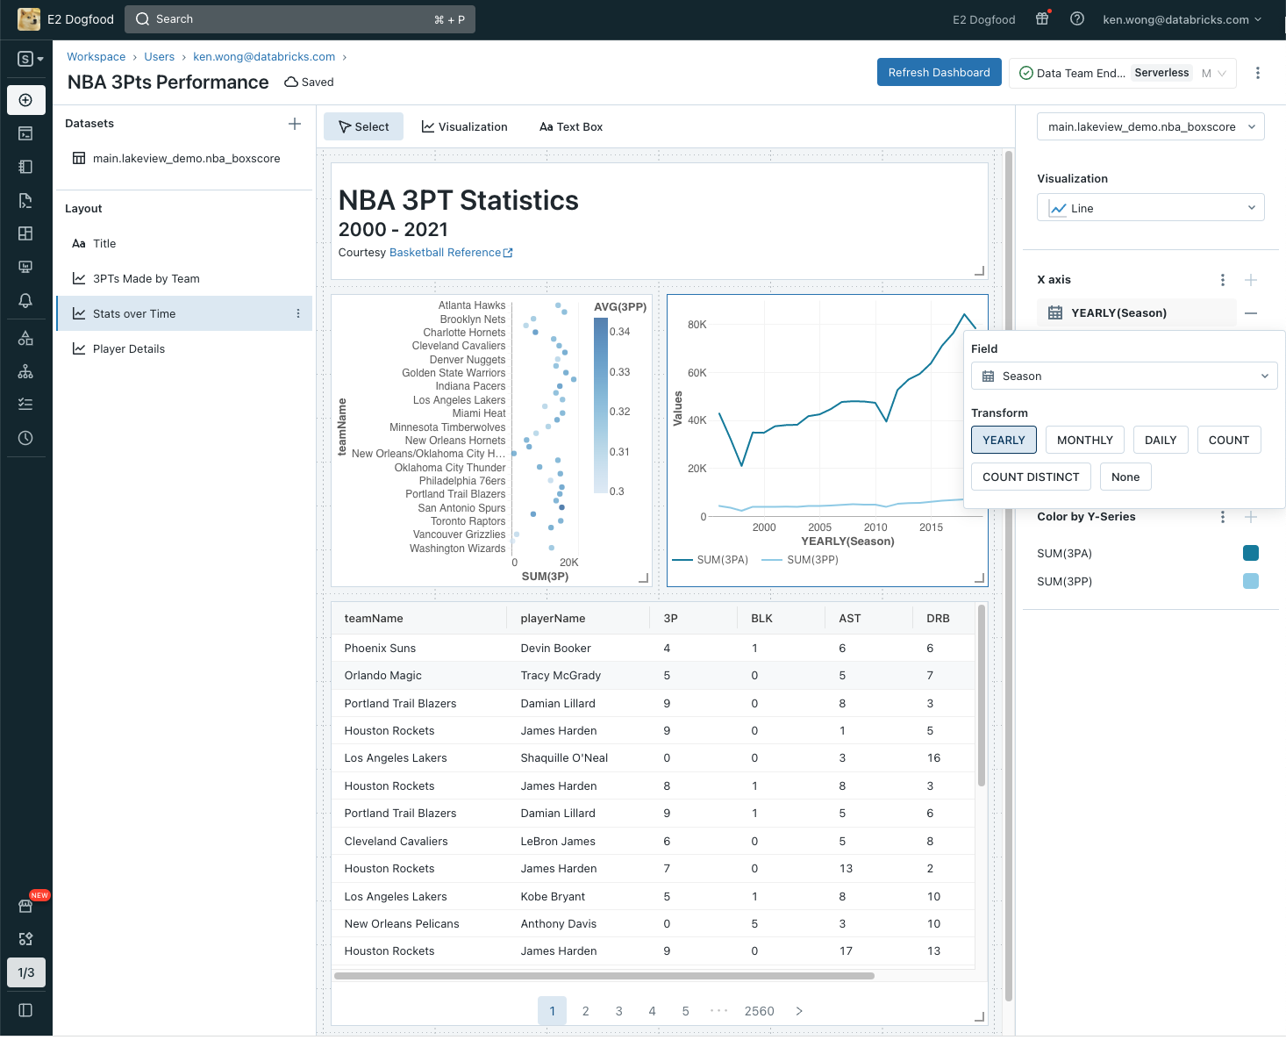
Data Consumption: Lakeview Dashboards
Simple and Beautiful
Simplified content model, new visualization library, and SQL-optional UX experience
Optimized for Distribution
Publish and Share to Org
Platform Integration
Unity Catalog powered dataset search and lineage
Notes:
Which is why we’re doubling down and building out a full fledged BI capability within the aAkehouse. We call this effort “Lakeview”.
For our first ship point, we’re focused on the dashboarding experience . There are three goals for our first release.
We’re trying to make creating a beautiful dashboard as easy as possible, deliverin go an entirely UI driven, SQL-optional experience for most common use cases.
We’re also trying to make it as easy as possible to share and distribute these dashboards to the people who need them, irrespective of whether they are an existing databricks user or not. And we want to make ure these dashboards load as quickly as possible with optional materialization.
Finally, we want to make sure everything is governed and secured. This means redesigning our security model so that no longer need to rely on impersonation (i.e. run as owner) to share data, but rather build upon the securityl established by Unity catalog.

Slide 9
Python User Defined Functions
Run Python UDFs from an isolated execution environment
Integrate Machine Learning models, custom logic & bring the flexibility of Python right into Databricks SQL!
CREATE FUNCTION redact(a STRING)
RETURNS STRING
LANGUAGE PYTHON
AS $$
import json
keys = ["email", "phone"]
obj = json.loads(a)
for k in obj:
if k in keys:
obj[k] = "REDACTED"
return json.dumps(obj)
$$;
Notes:
Python UDFs for DBSQL
Access and run Python UDFs directly from within DBSQL, while still maintaining an isolated execution environment.
AWS / Azure / GCP
In Development
Private Preview (Q2)

Slide 10
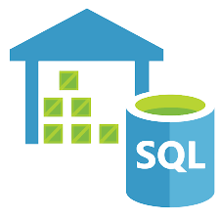
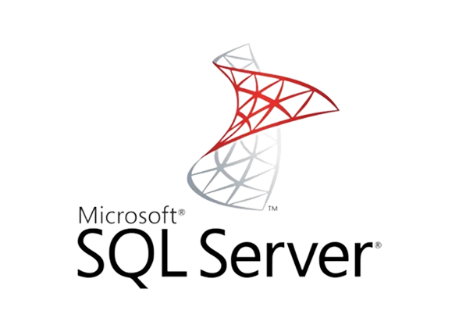

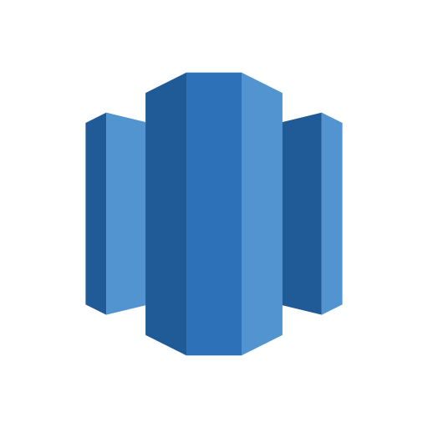

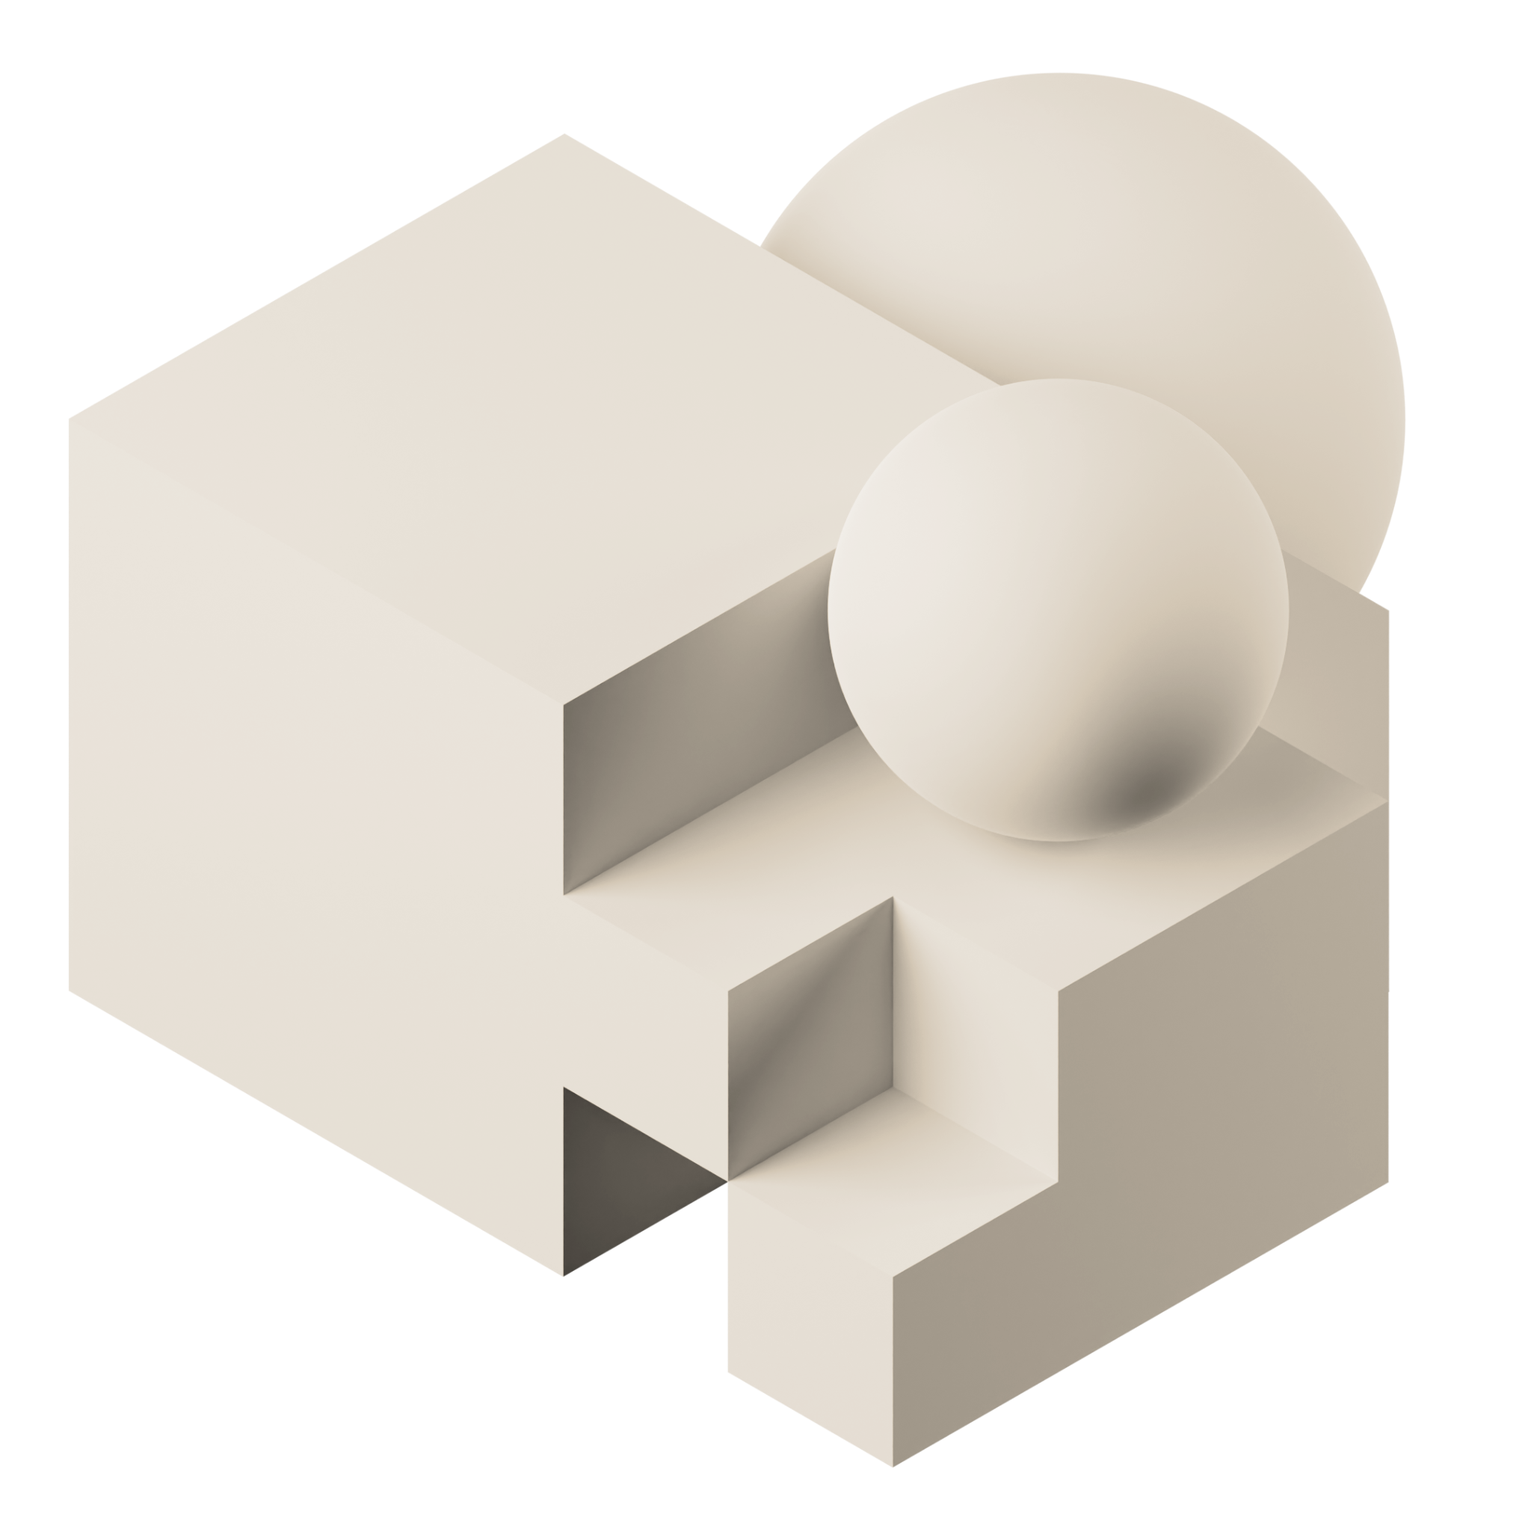

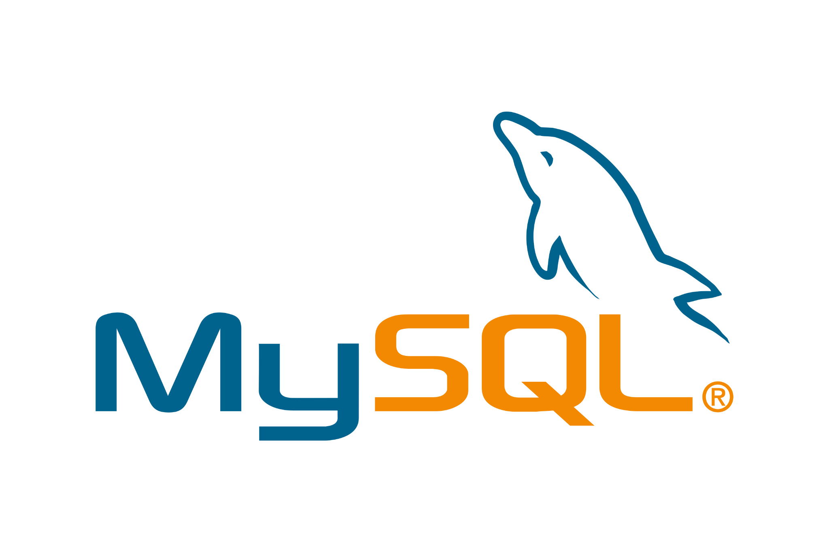
Lakehouse Federation
Discover, query, and govern all your data - no matter where it lives
Unified view into all your data
Unified engine for all your data and use cases
Unified governance across all data sources
Users
Dashboards
Notes:
Lakehouse Federation addresses these critical pain points and makes it simple for organizations to expose, query, and govern siloed data systems as an extension of their lakehouse. With these new capabilities now you will get:
A unified view of your data estate: Automatically classify and discover all your data, structured and unstructured, in one place and enable everyone in your organization to securely access and explore all the data available at their fingertips - no matter where it lives.
A unified engine for all your data and use cases: Query and combine all data efficiently with a single engine, and accelerate ad-hoc analysis and prototyping across all your data, analytics and AI use cases on the most complete data - no ingestion required. Advanced query planning across sources and caching ensure optimal query performance even when accessing and combining data from multiple platforms with a single query.
A unified governance model across all data sources: Use one permission model to set and apply access rules, and safeguard all your data across data sources. Apply rules like row and column level security, tag based policies, centralized auditing consistently across platforms, track data usage, and meet compliance requirements with built-in data lineage and auditability.

Slide 11
Built on an open foundation
Easily integrate with the entire data and AI ecosystem
Notes:
All of this has been built on open source and open standards
Integrating with tools you have today or new technologies you may adopt tomorrow is made simple
Additionally, Delta Lake’s Delta Sharing protocol allows you to easily share data and assets externally and internally without any vendor dependance
And even facilitate data cleanrooms for highly secure joint analytics with your partners

Slide 12

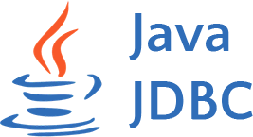

Data Consumption: Developer Ecosystem
Run SQL from anywhere and build custom data applications
Execute SQL statements over a REST API to access data managed by the Databricks Lakehouse Platform
Open Source Native Go & Node.js connectors with support for all the standard primitives and functionality
{REST:API}
Databricks SQL Warehouse
Notes:
SQL Execution API
The API provides access to data managed by the Databricks Lakehouse Platform by executing SQL statements over a REST API. This allows customers and partners to build data applications tailored to their needs. (PRD) Preview nomination form
GO & Node.js Connector
Providing native GO and Node.js interfaces for developing applications against DBSQL with support for all the standard primitives and functionality.
AWS / Azure / GCP
In Development
Private Preview (Q2)

Slide 13
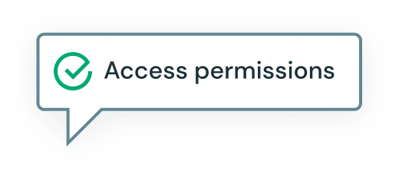
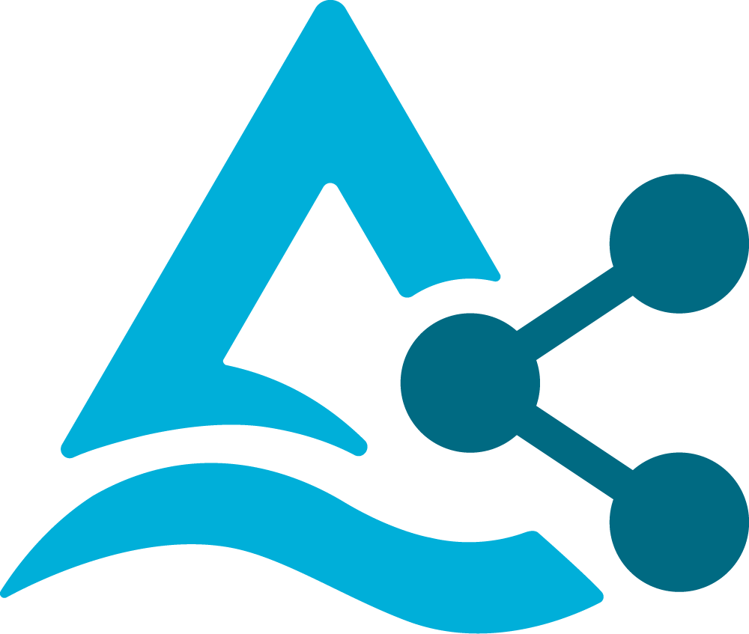
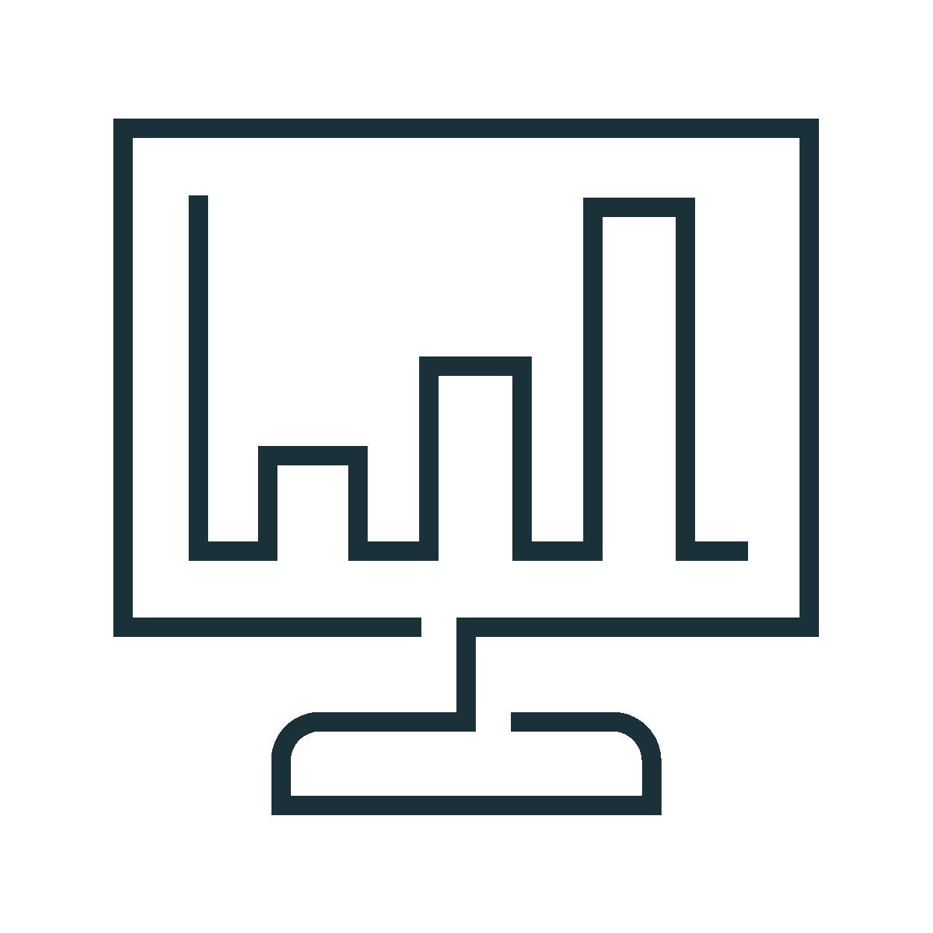

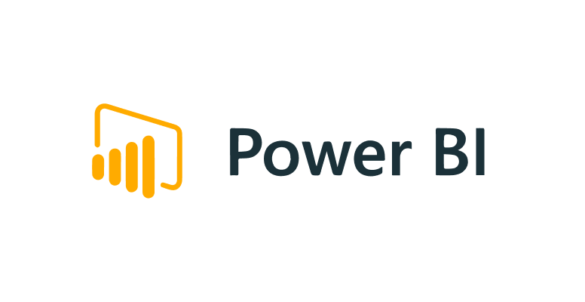
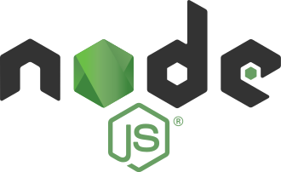
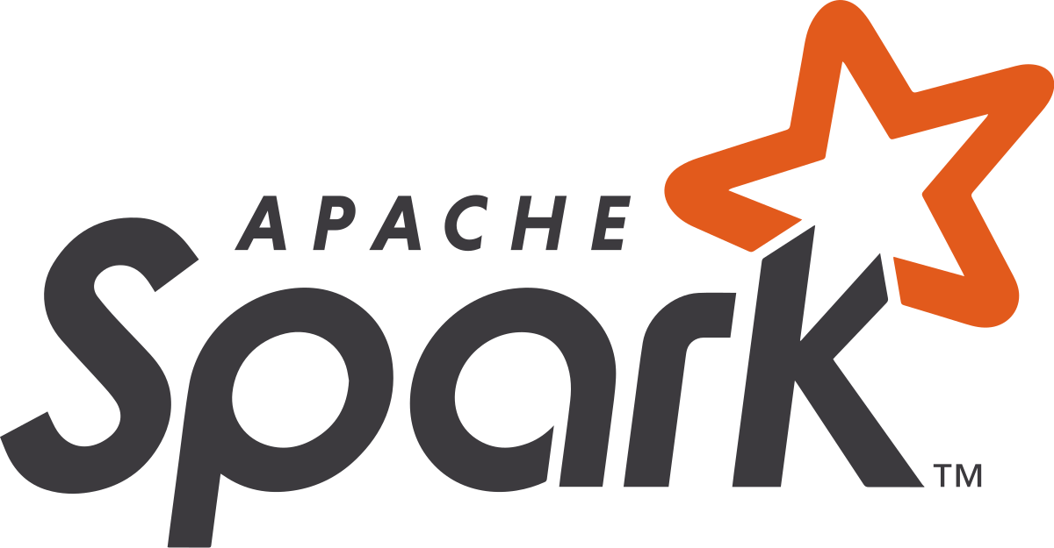
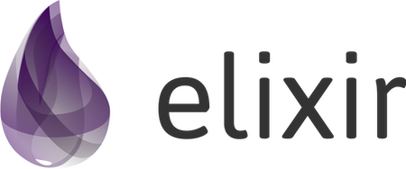
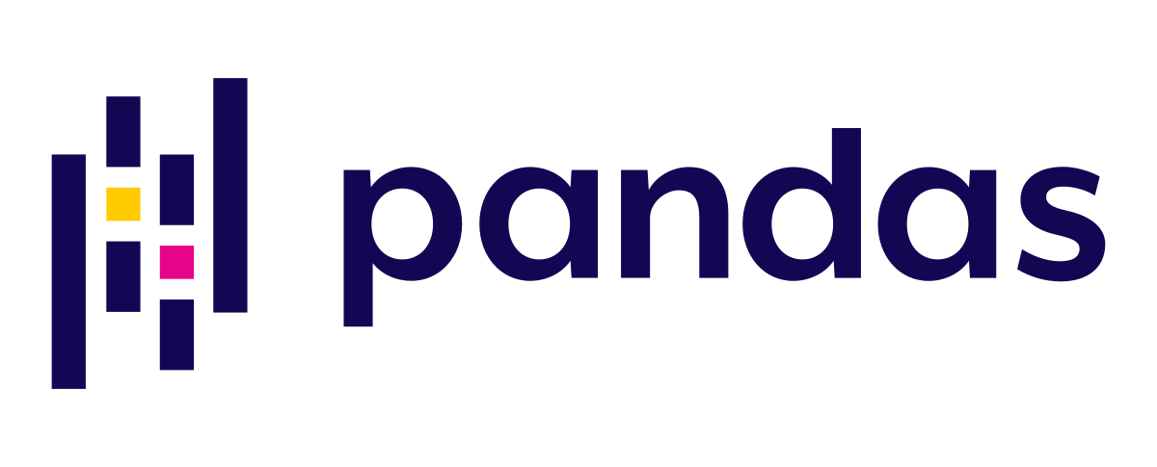
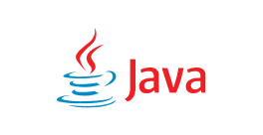

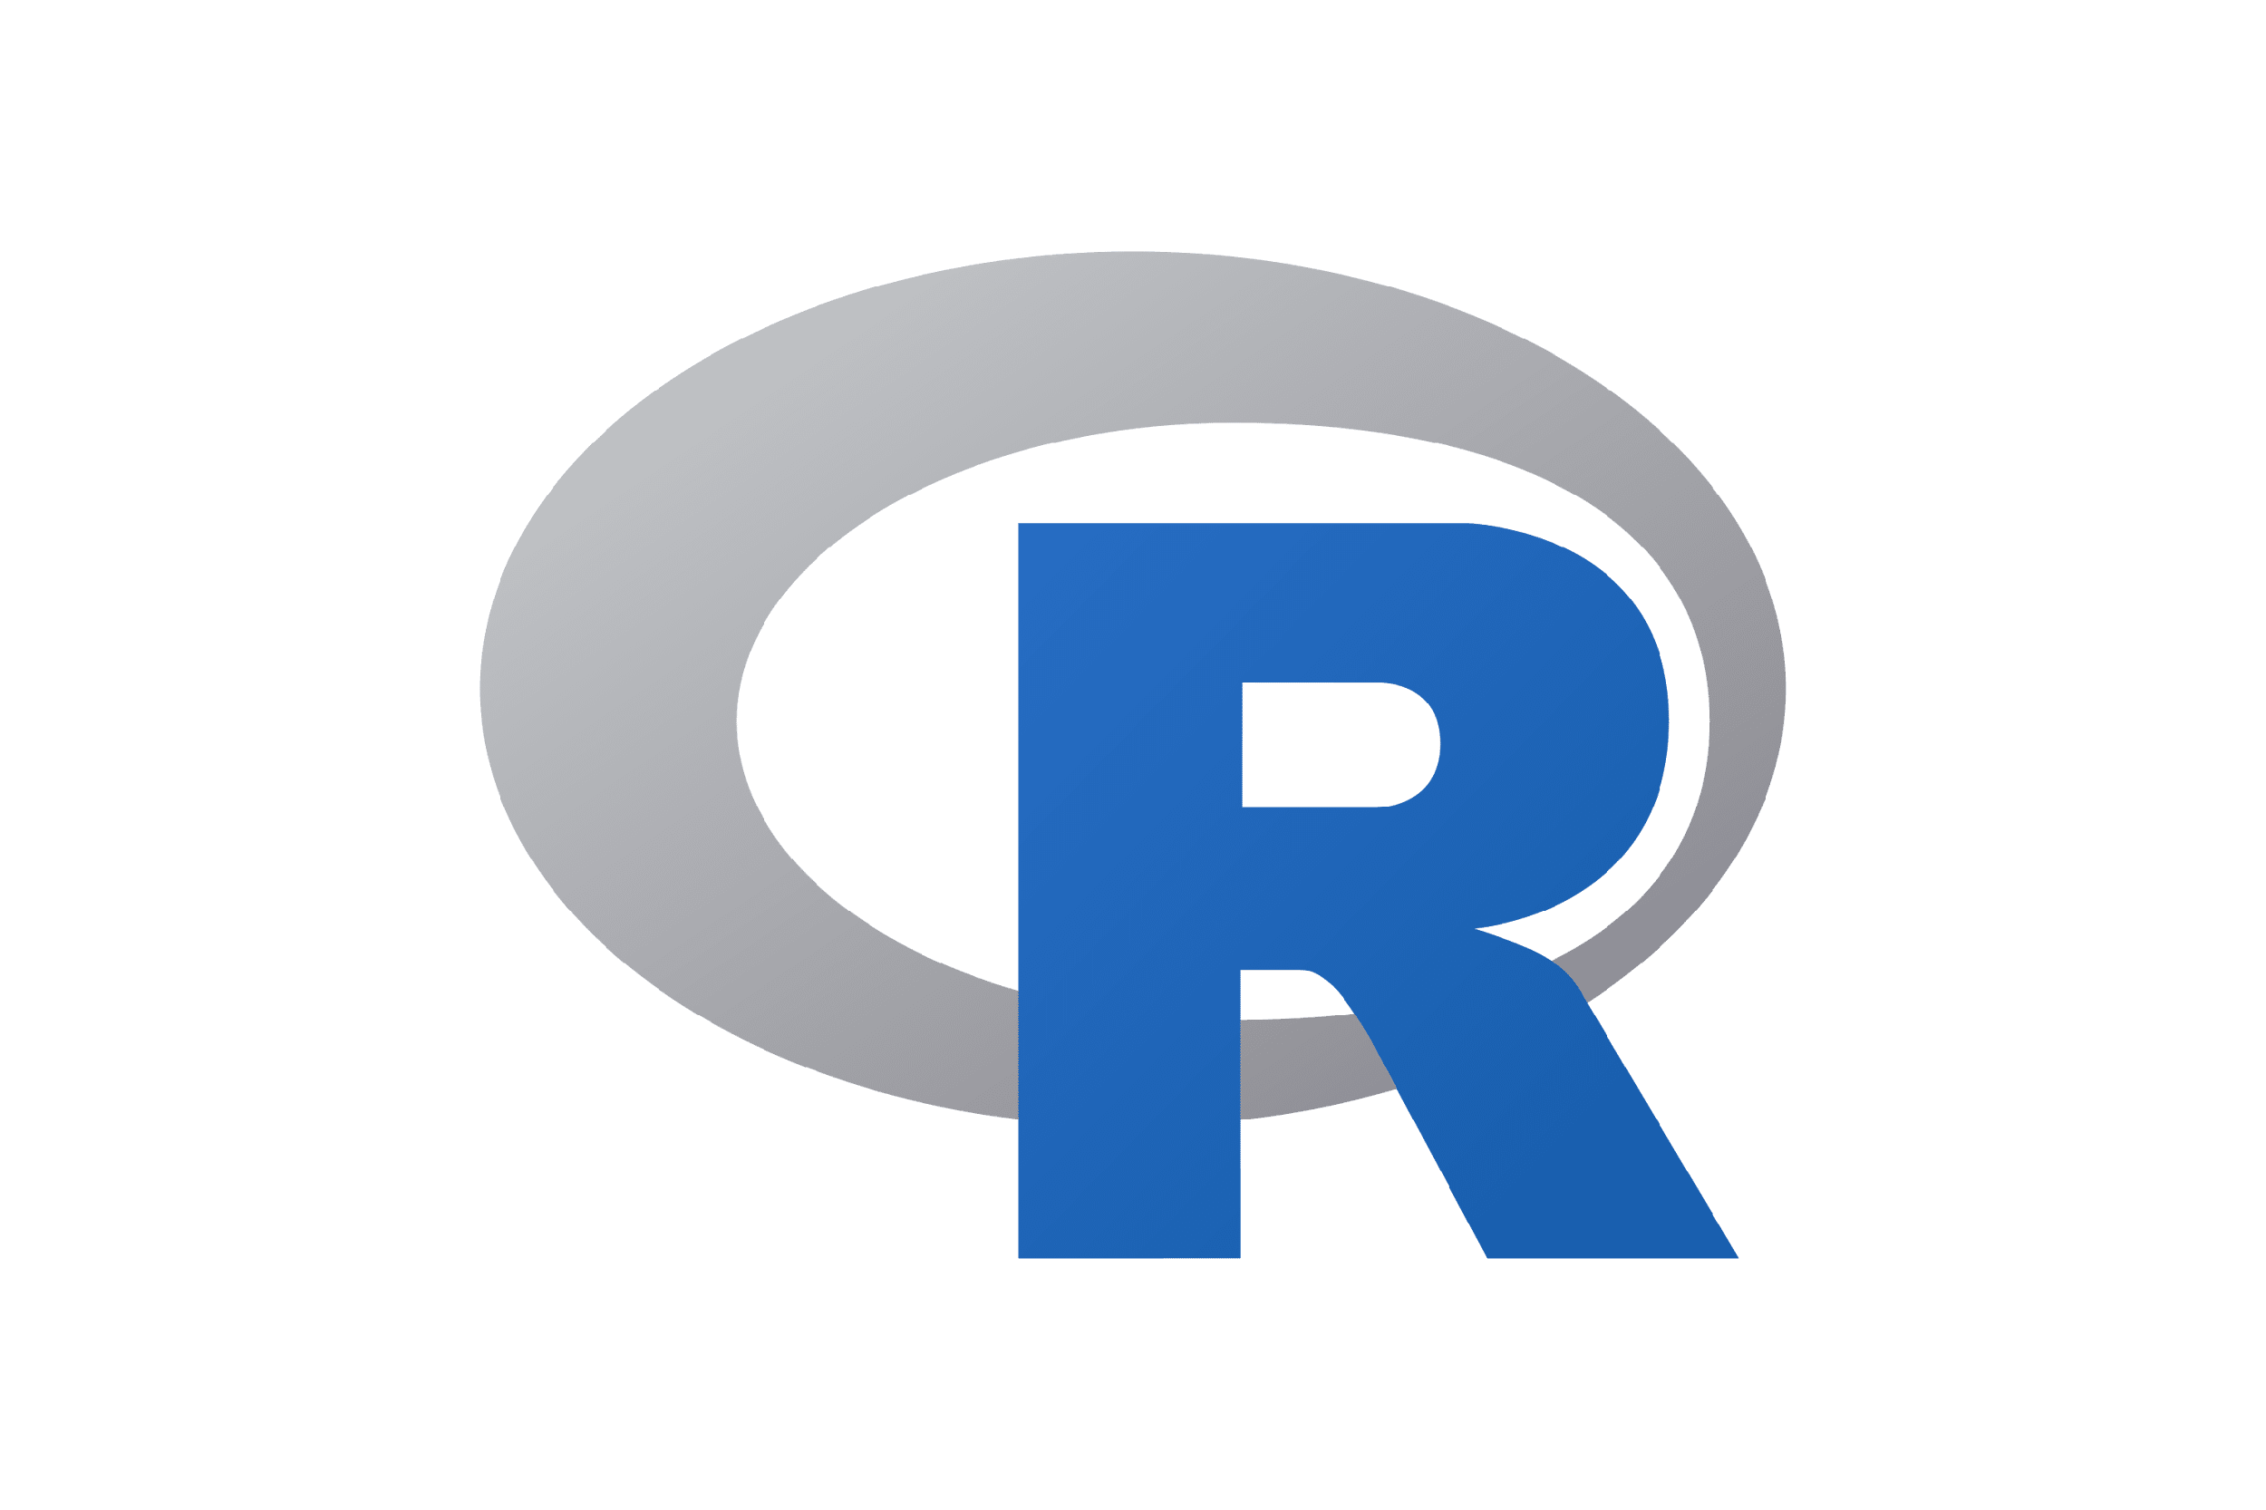
Delta Sharing
Databricks Notebooks, Delta Live Tables
Curated Data
Architecture
BRONZE
SILVER
GOLD
Raw Ingestion and History
Filtered, Cleaned, Augmented
Business Aggregates & Data Models
DATA PROVIDER
DATA CONSUMER
Activation link
Request table
Pre-signed short-lived URLs
Delta Lake
Delta Sharing Server
Delta Sharing Connectors
Temporary direct access to files (parquet format) in the object store - AWS S3, GCP, ADLS
Parquet files
in cloud storage
…

Slide 14
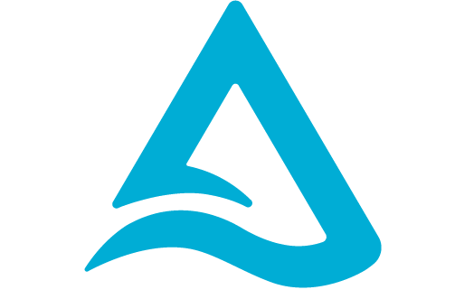
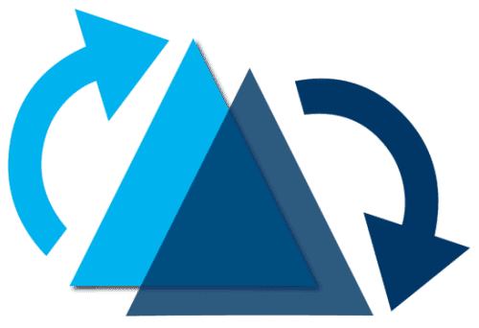


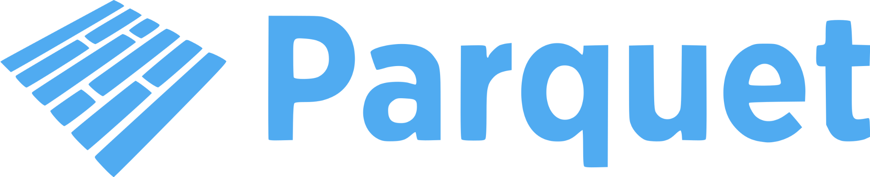
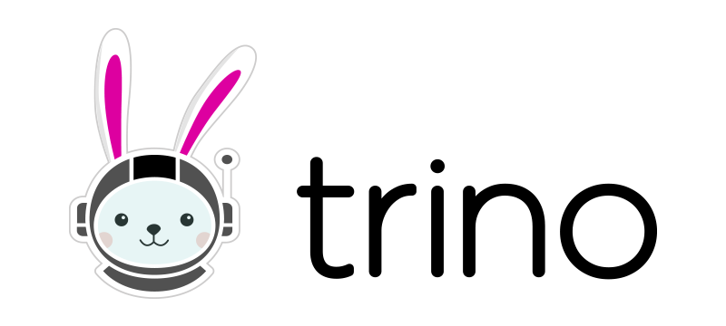

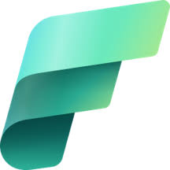
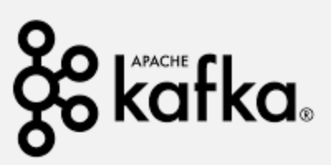
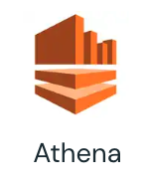
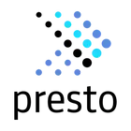
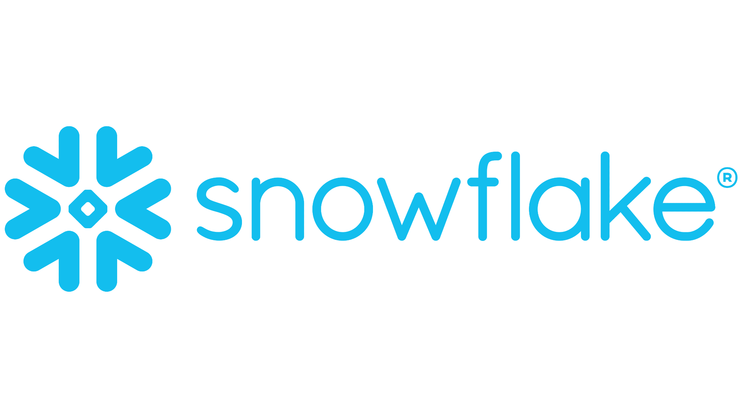
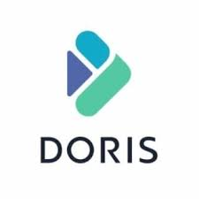


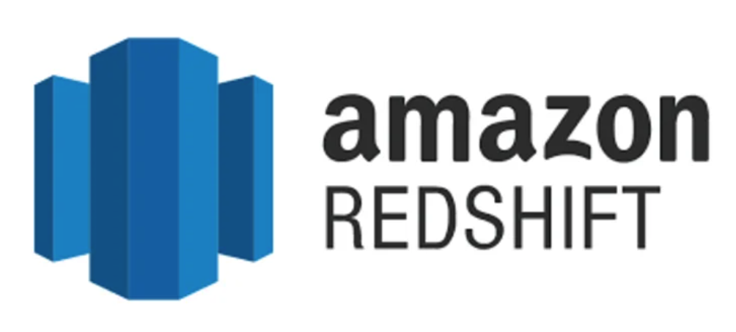



Delta Universal Format (Uniform)
Architecture
Databricks Notebooks, Delta Live Tables
Delta Lake
With UniForm
Curated Data
Metadata
Used for transactional source of truth, concurrency control, etc.
Metadata
UniForm
Data
All formats use Parquet!
Parquet
BRONZE
SILVER
GOLD
Read Delta as Iceberg
Microsoft
Fabric
Raw Ingestion and History
Filtered, Cleaned, Augmented
Business Aggregates & Data Models
Connector Ecosystem

